Slide 1
CHAPTER 5
Multivariate Probability Distributions

Slide 2
OBJECTIVES
The Distribution of a Linear Combination

Slide 3
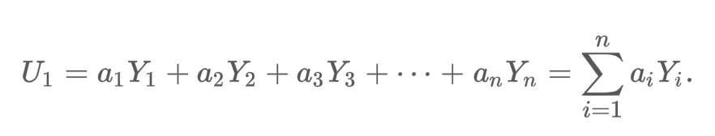
The Distribution of a Linear Combination
Given a collection of n random variables Y₁, Y₂, Y₃, …, Y_{n} and n numerical constants a₁, a₂, a₃, …, a_{n} the rv
is called a linear combination if the Y_{i}’s.

Slide 4
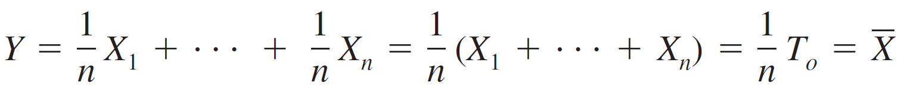
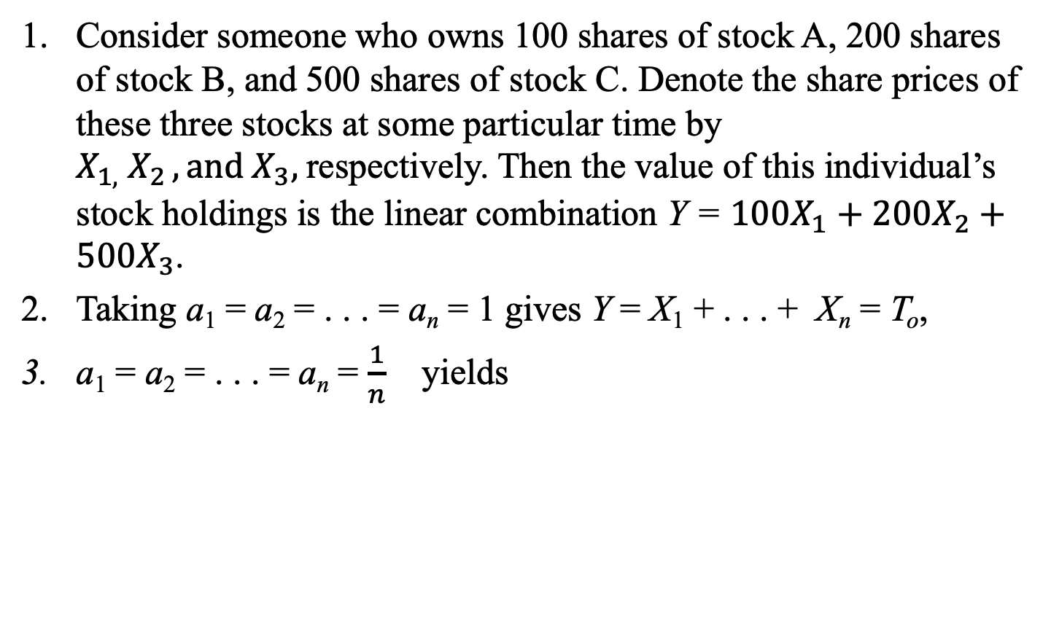
Examples
Consider someone who owns 100 shares of stock A, 200 shares of stock B, and 500 shares of stock C. Denote the share prices of these three stocks at some particular time by $X_{1,}{ X}_{2 }, and X_{3},$respectively. Then the value of this individual’s stock holdings is the linear combination Y = $100X_{1}+200X_{2}+500X_{3}$.
Taking a₁ = a₂ = . . . = a_{n} = 1 gives Y = X₁ + . . . + X_{n} = T_{o},
a₁ = a₂ = . . . = a_{n} = $\frac{1}{n}$ yields
Notice that we are not requiring the X_{i}’s to be independent or identically distributed.
All the X_{i}’s could have different distributions and therefore different mean values and
variances.
We first consider the expected value and variance of a linear combination.

Slide 5
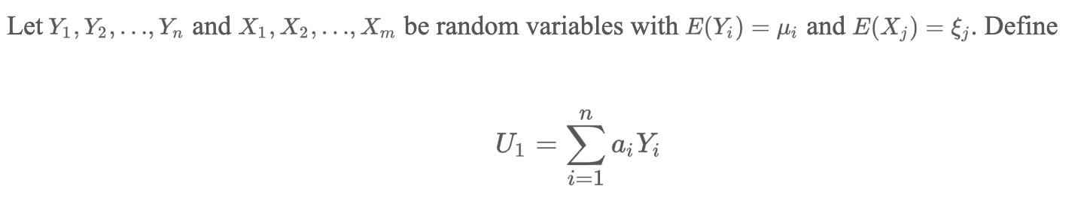
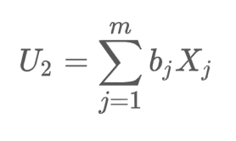

The Distribution of a Linear Combination

Slide 6
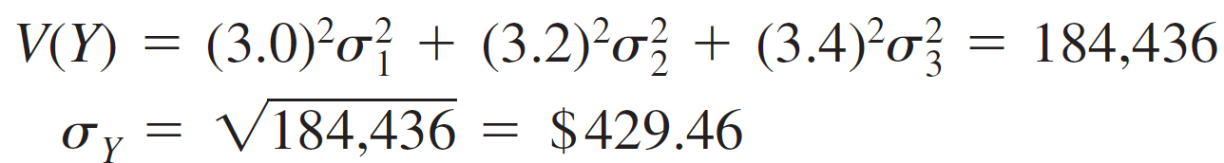
Example 1
A gas station sells three grades of gasoline: regular, extra, and super.
These are priced at $3.00, $3.20, and $3.40 per gallon, respectively.
Let X₁, X₂, and X₃ denote the amounts of these grades purchased (gallons) on a particular day.
Suppose the X_{i}’s are independent with μ₁ = 1000, μ₂ = 500, μ₃ = 300, σ₁ = 100, σ₂ = 80, and σ₃ = 50.
The revenue from sales is Y = 3.0X₁ + 3.2X₂ + 3.4X₃, and
E(Y) = 3.0μ₁ + 3.2μ₂ + 3.4μ₃
= $5620

Slide 7
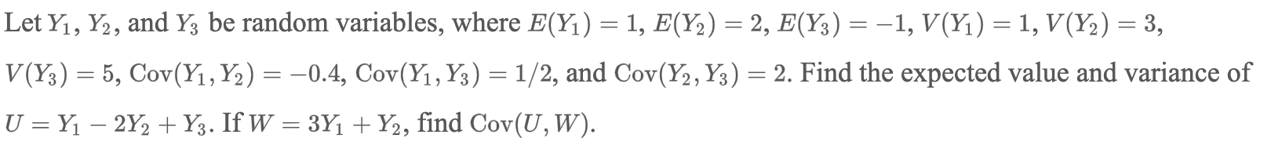
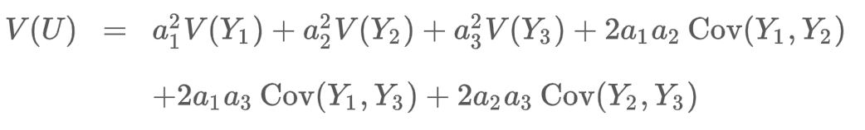
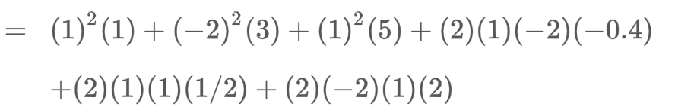

Example 2
Sol

Slide 8
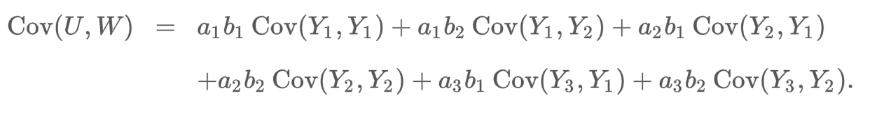

Example 2 contd’

Slide 9
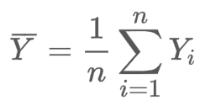
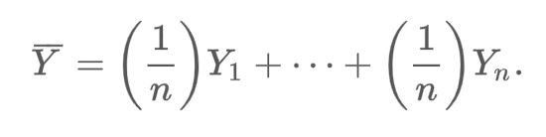
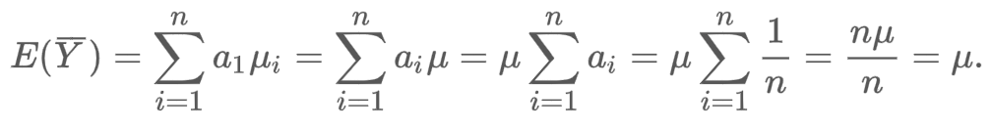
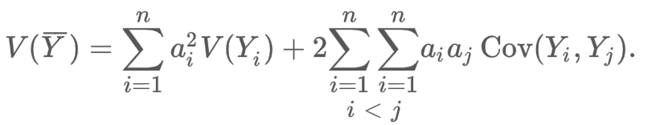
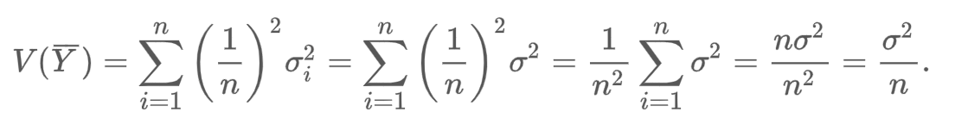

Example 3
Show that $E\left(\overline{Y}\right)=μ and V\left(\overline{Y}\right)=\frac{σ^{2}}{n}$, where
Sol

Slide 10
The Difference Between Two Random Variables

Slide 11
The Difference Between Two Random Variables
An important special case of a linear combination results from taking n = 2, a₁ = 1, and a₂ = –1:
Y = a₁X₁ + a₂X₂ = X₁ – X₂
E(X₁ - X₂) = E(X₁) – E(X₂) for any two rv’s X₁ and X₂.
V(X₁ – X₂) = V(X₁) + V(X₂) – 2 Cov(X₁, X₂).
V(X₁ – X₂) = V(X₁) + V(X₂) if X₁ and X₂ are independent rv’s

Slide 12
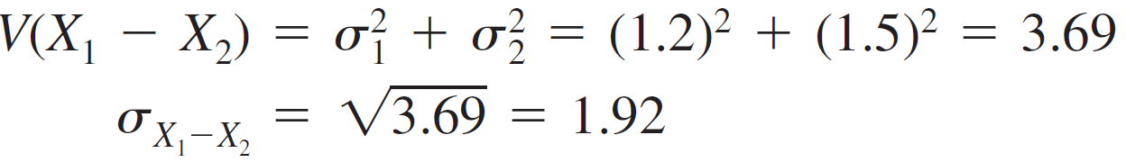
Example 4
A certain automobile manufacturer equips a particular model with either a six-cylinder engine or a four-cylinder engine.
Let X₁ and X₂ be fuel efficiencies for independently and randomly selected six-cylinder and four-cylinder cars, respectively.
With μ₁ = 22, μ₂ = 26, σ₁ = 1.2, and σ₂ = 1.5,
E(X₁ – X₂) = μ₁ – μ₂
= 22 – 26 = –4

Slide 13
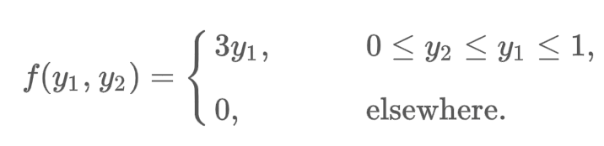
Example 5
Gasoline is to be stocked in a bulk tank once at the beginning of each week and then sold to individual customers.
Let Y₁ denote the proportion of the capacity of the bulk tank that is available after the tank is stocked at the beginning of the week. Because of the limited supplies, Y₁ varies from week to week.
Let Y₂ denote the proportion of the capacity of the bulk tank that is sold during the week. Because Y₁ and Y₂ are both proportions, both variables take on values between 0 and 1. Further, the amount sold, y₂, cannot exceed the amount available, y₁.
Suppose that the joint density function for Y₁ and Y₂ is given by
Find the variance of Y₁ - Y₂, the proportional amount of gasoline remaining at the end
of a week.

Slide 14
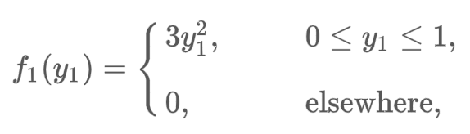
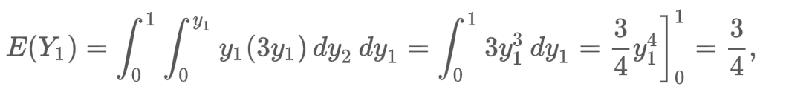
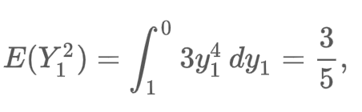

Example 5 cont’d
Sol

Slide 15
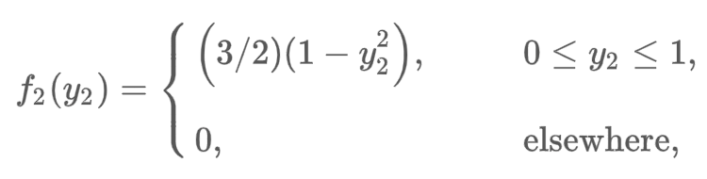
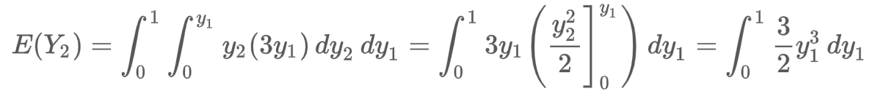
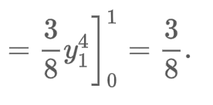

Example 5 cont’d

Slide 16
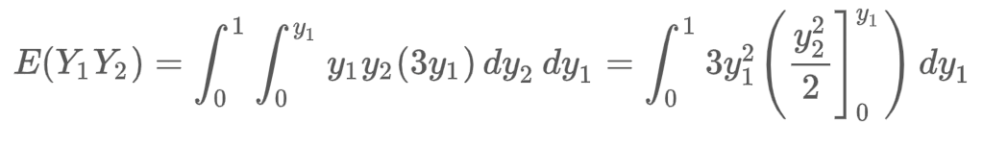
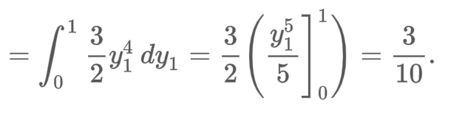
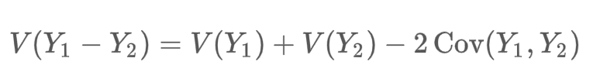

Example 5 cont’d

